Slide 1
How Do YOU MAKE DECISIONS? Mary Atwater, Psy.D, may 14, 2015

Slide 2
welcome
Why I am here – What I value
Why you are here? – What you value
Goals
new language
new perspective
new tools

Slide 3
Conflict requires Positions
Conflict is Inevitable
Why do we take positions?
What is the gain? The loss?
“Blame Game”
Positional Conflict - adversarial, win – loose
Our Bias’ assumes rational, rule bound behavior
Mediation - irrational territory, win-win

Slide 4
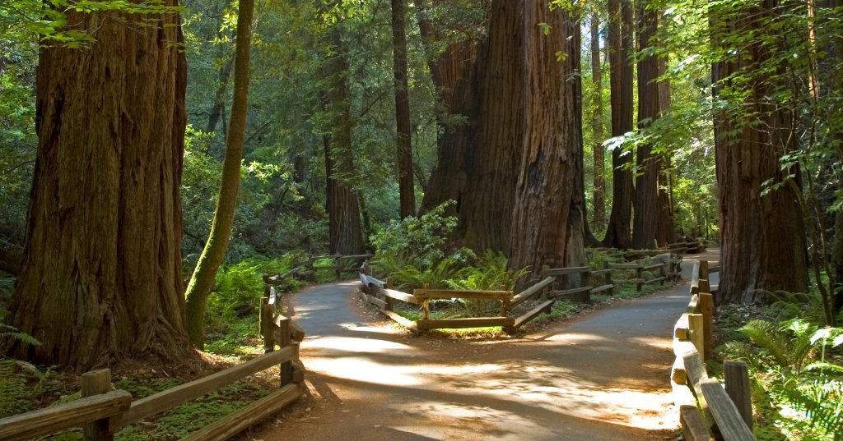
Valued direction
Notes:
Valued Direction.
Photograph taken in Muir Woods California. The scene is filled with large redwood trees, green leaves and a path in the center. The path separates into two paths with a large redwood tree in the center.

Slide 5
neuroeconomics
NeuroEconomics is an interdisciplinary field working to explain human decision making; process multiple alternatives and follow a course of action.
Goal Directed behavior in the presence of options which assume:
There are options to choose between
We choose in a non-random way
Our choices are goal-directed
Ladder of Inference

Slide 6
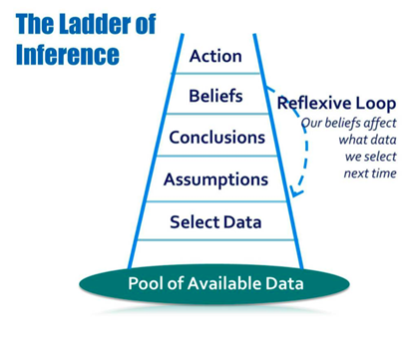
Ladder of inference
Notes:
Identify – Observe
Collect – Select and Add Meaning
Produce Solutions – Assume Based Off Meaning
Evaluate - Conclude
Choose – Adopt and Act

Slide 7
thinking fast and slow
Daniel Kahneman: "Thinking, Fast and Slow”
Two types of information processing: Each impact how we perceive input, draw associations, and how we are then “primed” for our experience.
System one – Automatic Reaction = “Fire”
Systems two – Attention + Effort = Agency
Priming the mind, “What is Possible or Not Very Likely?”
www.youtube.com/embed/JiTz2i4VHFw
Notes:
You Tube Video - Brain Tricks - This Is How Your Brain Works
<iframe width="560" height="315" src="//www.youtube.com/embed/JiTz2i4VHFw" frameborder="0" allowfullscreen></iframe>
http://youtu.be/JiTz2i4VHFw

Slide 8
Thinking makes it so
Brain
Structure, Memory and Chemistry
Inflexible or Flexible
depends on who we are and where we have been and where we want to go
Cognitive Bias

Slide 9
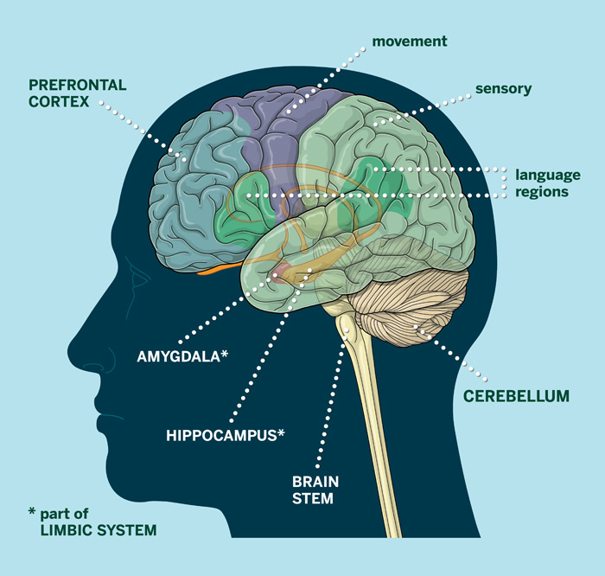
Emotional Brain
Thinking
Emotional
Notes:
Picture of a side view of a brain. The picture identifies the Prefrontal cortex on top left, sensory top right, language regions towards the back right, and the emotional limbic system dead center. An large golfd arrow shows pathway from limbic to the prefrontal cortex, middle to upper left right.
Thinner broken red arrows, weaker pathway from prefrontal cortex to the middle limbic system area.

Slide 10
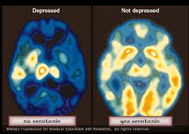
Sad Brain
Notes:
Two MRI pictures showing top down view of a slice of brain. Blue represents the non-active sites and yellow and darker yellow to orange showing brain activity. Two views of a brain. Left MRI scan is labeled Depressed and has mostly blue areas with some yellow. The MRI scan to the right is labeled Not Depressed. When looking at both MRI scans, you can clearly see that the Not Depressed scan shows mostly yellow indicating greater brain activity.

Slide 11
inflexible
Inflexible
Locked
Inside
A box
Flexible
Open
Light
Imagine

Slide 12
Inflexible
Worst time in my life. It will “Never Ever” be the same
I’ll get even!
I won’t let you win!
This is so unfair! I don’t want this!
I am so hurt.
Someone has to pay for my pain
I deserve more
Never live this down
I’ll never be respected here.
Notes:
Picture shows a person’s head with thought bubbles above, indicating individual thoughts.
Inflexible
I deserve more
This is so unfair! I don’t want this
Worst time I my life. It will Never Ever be the same again.
Never live this down
I’ll get even

Slide 13
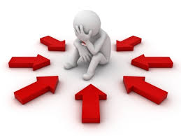
Notes:
Picture of a illustrated person, drawn in black and white, sitting down, holding it’s head, posture makes them look defeated. The person is surrounded by large red arrows all pointing to the person who is sitting in the middle. The picture gives the appearance of a stuck and defeated person who is Immobilized.

Slide 14
Flexible Thinking
Flexible Thinking is a willingness to …
Be open to possibility…
allow for additional thoughts and options…
consider different perspectives..
Showing up for oneself and one’s role in the Mediation Process
Flexible Thinking is…being present in “Here - Now”

Slide 15
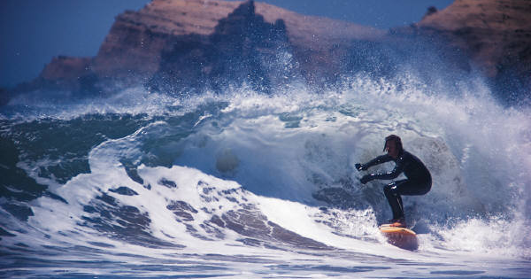
Flexible - workable
Notes:
Picture
Ocean scene with crashing waves of water in the foreground and large rock formations in the background.
In the water is a Surfer riding a wave moving towards shore.

Slide 16
Sometimes things change that I can’t control, and that is OK
Flexible Thinking Looks Like
Time and direction, he/she will make a good employee
I won’t know if I will like something until I try it
This is not worth being upset about
This won’t be as bad as my mind keeps telling me
The way other people do things is okay, and might teach me something new
I will help my co-worker to be the best they can be
Notes:
Picture, Person’s head with bubbles above the head, indicating thoughts
I will help my co-worker to be the best they can be.
The way other people do things is okay, and might teach me something new.
This is not worth being upset about.
The won’t be as bad as my mind keeps telling me.
Sometimes things change that I can’t control, and that is ok.
I won’t know if I will like something until I try it.
Time and directions, he/she will make a good employee.
This won’t be as bad as my mind keeps telling me.

Slide 17
Cognitive Bias
Emotional Memory
Emotional Context – Past, Future, or Here and Now
Prospect Theory
Probability – Predict Uncertainty
Endowment Effect
Boxes of Experience – emotional content
Capacity to ACT

Slide 18
Watching your thoughts
How can we imagine something that isn’t there?
When faced with intense situation, high conflict, What does our mind imagine?
The Worst = looks like
The Best = looks like
What is Possible - Probable?

Slide 19
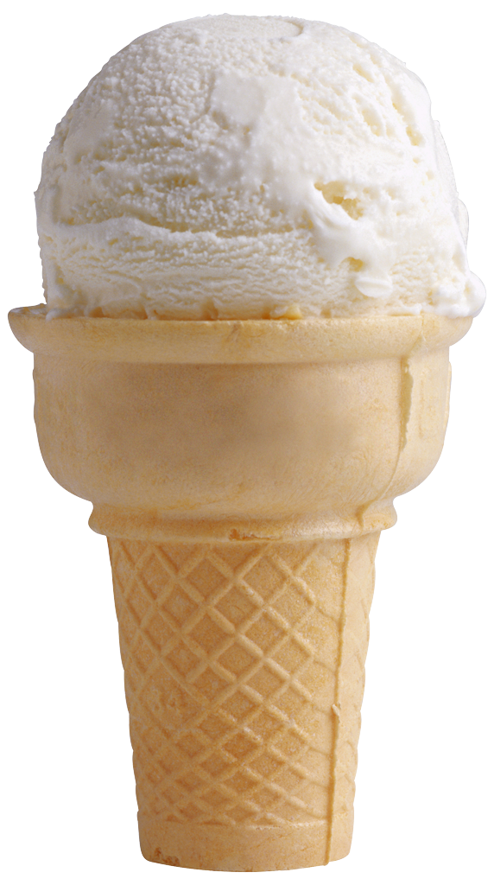
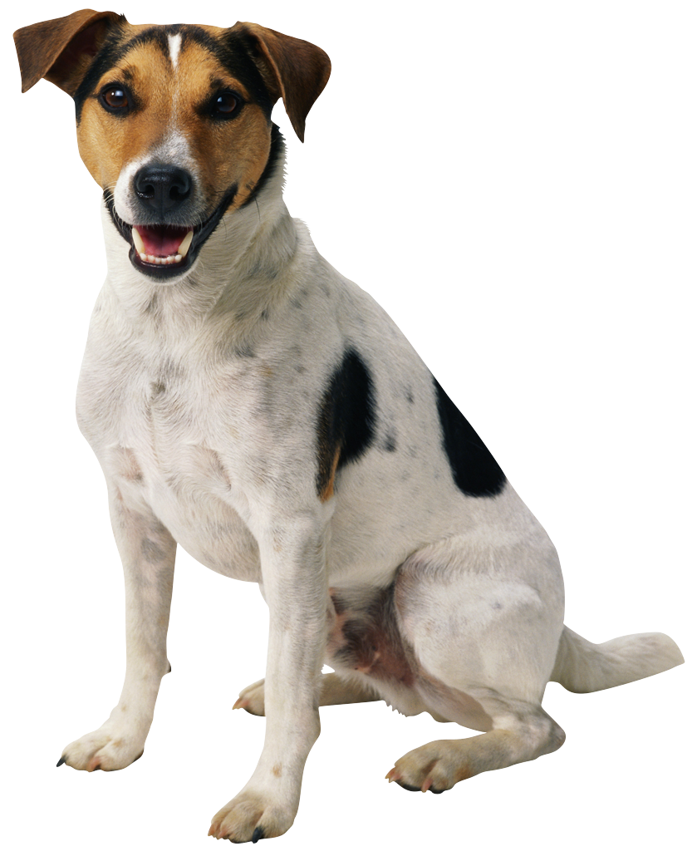
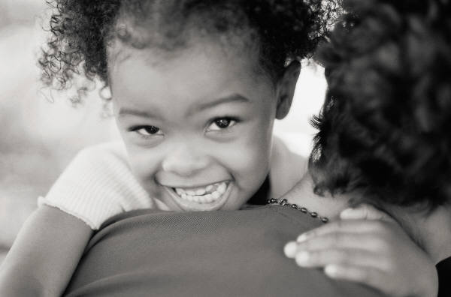
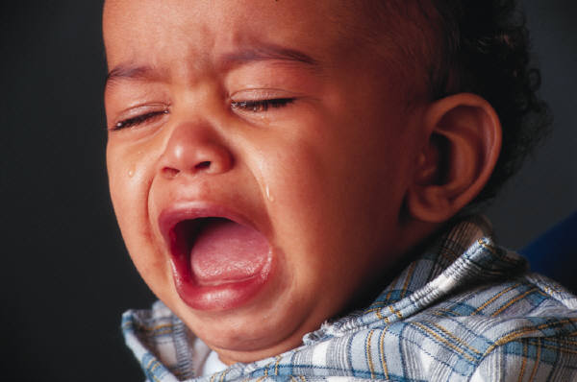
Notes:
Screen is broken into four different pictures arranged into quadrants. Upper left right has a nice little dog. Upper right shows a picture of a vanilla ice cream cone. Bottom left has a smiling black child hugging a parent. The bottom right shows a very young baby boy crying, mouth wide open and tears streaming down his face.

Slide 20
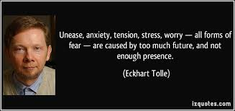
FUTURE - What if ?
Notes:
Picture of Eckhart Tolle

Slide 21
PAST => There - then
You cannot start the next chapter of your life if you keep re-reading the last one.
Our mind, our thoughts, keep us trapped in our past.
What is the power of the past story that is anchored there unable to move?

Slide 22
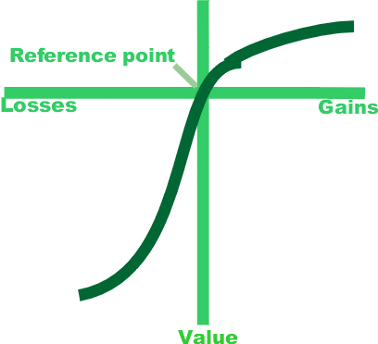
Prospect theory
Notes:
Graph depicting the intersection and reference point of losses to gains and to negative to positive value.

Slide 23
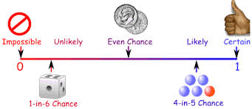
Worry about probability
Notes:
A graph depicting probability. Zero to !.
The left side is labeled, Improbable and the right side is labeled Certain.
The graph moves from the left to right showing: Starting at Zero and Impossible, next to “Unlikely” with a 1-in-6 Chance, farther in then to the middle, Even Chance, moving further to “Likely” 4-in-5 Chance, and ends with “Certain” on the far right of the graph.

Slide 24
Endowment effect
How much is it worth?
What would you pay?
Try it for 30 days.
Use now, pay later.

Slide 25
WE all arrive by different streets” Pablo Neruda
Employee
Boss
State
college
Played
Sports
Travel
World
Arts
Private schools
4.0 grades
Wealth
Class
clown
Arts
Strict
parents
Harsh discipline
Religion
Ignored
Isolated
Large Family
Small town
Walked
school
No camp
Only child
Moved a lot
Many camps
Notes:
We all come from different background. Family, culture, history, rules. There are two sets of boxes. Each box represents a different life experience. The employee’s set of boxes are labeled: large family, small town, walked to school, no summer camp, religion, strict parents, harsh discipline, class clown, arts, state college. The Boss’s set of boxes are labeled: only child, moved a lot, many camps, ignored, isolated, private schools, straight A’s, wealthy, played sports, exotic trips.

Slide 26
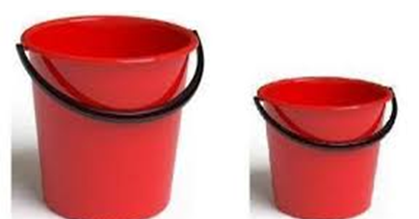
Capacity
Notes:
The picture shows two red buckets.
One bucket is larger and can hold more than the smaller bucket.

Slide 27

Hooked by a thought
I can become hooked by a belief, a thought and carry it around – reifying it. Mind makes it true!
Notes:
Small drawing of a fish in water with its mouth open heading for a hook.

Slide 28
Stuck => Unstuck
Inflexible
I believe my worried, sad, bad thoughts, to be TRUE.
This will be the worst thing that ever happens to me.
It is not FAIR and terribly wrong.
Flexible
My mind is racing around with powerful emotions.
How can I calm my mind and show up during this process?
Let go and have another thought.

Slide 29
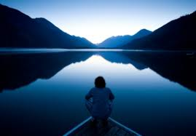
Here - now
Notes:
Picture of the back of a person sitting on a dock with the water view of a lake in the mountains. The lake reflects the mountains in the background.
The person seems contemplative.

Slide 30
Valued direction
Notes:
Valued Direction.
Photograph taken in Muir Woods California. The scene is filled with redwood trees, green leaves and a path in the center. The path separates into two paths with a large redwood tree in the center of the photo.

Slide 31
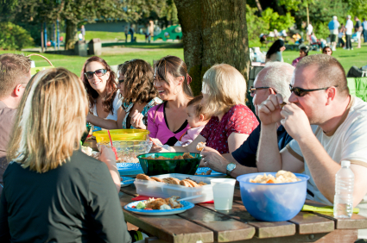

Acceptance =>Moving forward
Important Events
Office Harmony
Imagine, Curious, Willing and Open
Notes:
Side by side images. Image on the left is a company picnic. Employees sitting around a table having a meals. People are smiling, eating, and appear to be enjoying themselves. The image to the right is a green peace symbol.

Slide 32
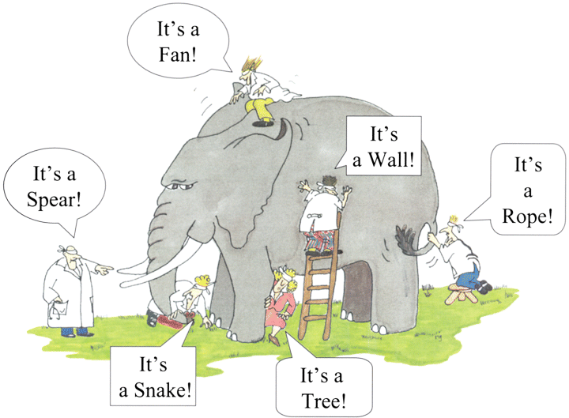
Seeing all sides - many perspectives
Notes:
Classic Taking Perspectives picture. An elephant and six people wearing blindfolds. Each describes what they think they are touching. The person in front, touching the elephants tusk says, “It’s a spear!”
The person on the ground, touching the skin says, “It’s a snake”
The person holding the elephant’s leg states, “It’s a Tree!”
The person sitting on top of the elephant feels the ear waving and remarks, “It’s a fan!”
The person who has climbed up a ladder that puts him up against the side of the elephant, touches it and states, “It’s a wall!”
The person at the rear of the elephant, grabs a hold of it’s tail saying, “It’s a rope!”
We all have our perspectives and vantage points. No one in this picture is right, all of them are blindfolded, and limited to their others sensory input. They all report on the data they have, they are not wrong about their perceptions, Yes?

Slide 33
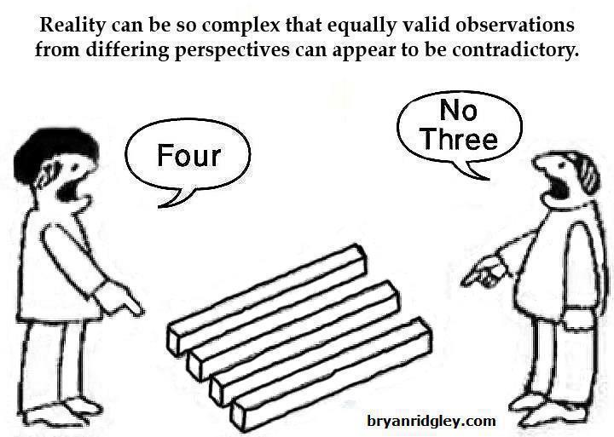
Notes:
Picture shows an optical illusion. Two people at odds with what lays between them. From one person’s position it looks like there are four boards, 2 by 2 by 3 feet.
And from the other person’s position, it looks like there three boards. Each person states what they believe to be true from their position.
The illusion is that when looking from each perspective, each of them is visibly correct.

Slide 34
Ladder of inference
Notes:
Picture of the head. Ladder of Inference. The ladder starts at the bottom with Observable data and experiences, (as a videotape recorder might capture it). The next rung on the ladder going upward is “I select Data from what I observe”. Moving up on the ladder, I add Meanings (cultural and personal), up to the next rung is I make Assumptions based on the meanings I added. The next rug is I draw Conclusions. The next rug is I adopt Beliefs about the World. The top run of the ladder is labeled, I take Actions based on my beliefs. To the right of the ladder, is a broken arrow moving from the top of the ladder back down to the base of the ladder. The arrow is labeled, The Reflexive Loop (Our beliefs affect what data we select next time we make a decision)

Slide 35

Calm and thoughtful
Notes:
British Icon with the crown on top and Keep Calm statement

Slide 36
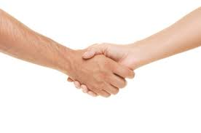
Action to support values
Notes:
Two peoples hands joined in a hand shake.

Slide 37
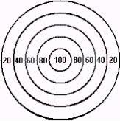
Committed action
Notes:
Picture of a bull's-eye
A diagram of 5 circles with the largest circle holding 4 smaller circles as the circles move inward and closer to the center, the bull's-eye, their value increases. Outer circle starts with the value of 20, moving in to 40, then 60, to 80 with the smallest inner circle, the bullseye, valued at 100.
Depicting that the closer you are to the middle the greater the value.

Slide 38
New ways to think and behave
Today’s Goals:
New language
New perspective
New tools
We discussed:
The differences between flexible and inflexible thinking
Workability of our thoughts
The Frontal Lobe shows up with Emotional Considerations
Letting shared values guide the mediation process

Slide 39
Conclusion
Questions?
Everyday is a new day to do something different
Thank you for allowing me to share my work with you.

Slide 40

Mary Atwater
Collaborative Mediation Services
Bethesda
Potomac
Maryland
CollaborativeMediationServices.com
Notes:
Picture of a stones, with two small stones balanced at the ends of a larger flat stone, which is balanced on top of a base stone.

